Slide 1
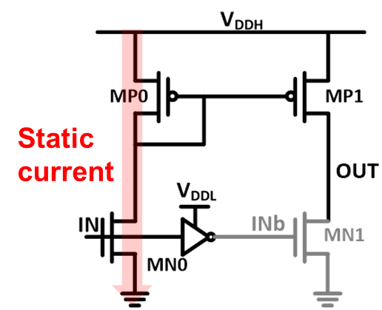
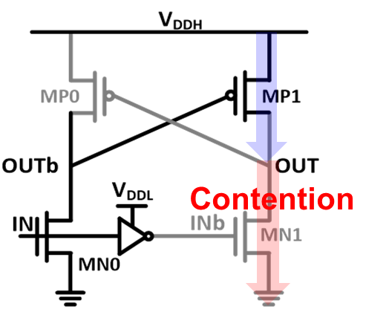
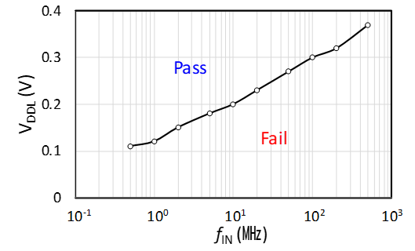
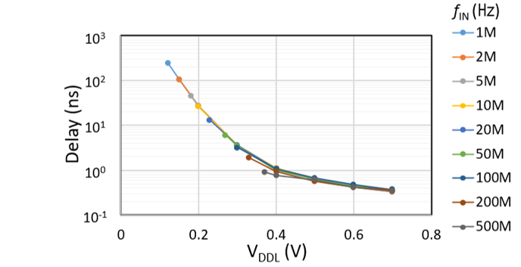
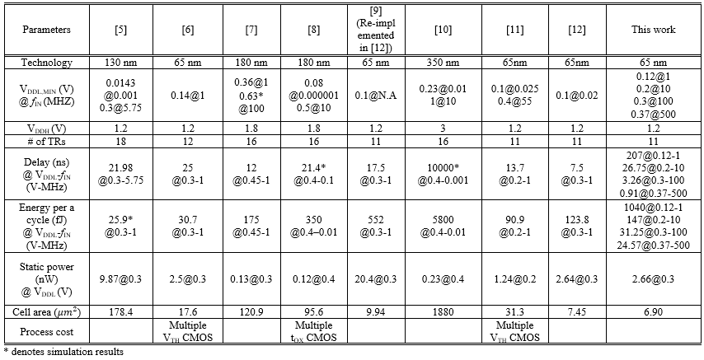
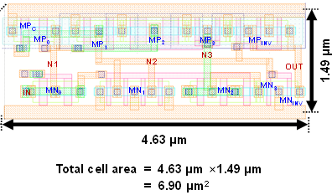
An Area and Energy efficient Level Shifter for wide voltage and frequency ranges
Kiryong Kim, Ji Young Kim, and Seong-Ook Jung
School of Electrical & Electronic Engineering Yonsei University
Introduction
  Operation
    Rising operation (‘0’ → ‘1’ )
    Falling operation (‘1’→’0’)
  Need for Level shifter
    Demand of artificial intelligence and big data analysis in battery-powered mobile or wearable devices ↑
    importance of low power and cost system-on-chip ↑
    Reducing V_{DD} for SRAM is hard due to process variation
    Separate domain is required.
    Level shifter for changing supply domain between separate V_{DD}s is required.
  Conventional Level shifter
    Current mirror-based level shifter (CMLS)
      Wide range operation owing to no contention problem
      Static current issue .
    Cross-coupled PMOS level shifter (CPLS)
      NO static current → less power consumption
      Narrower range operation than CMLS due to contention node by cross-coupled structure.
Current mirror based LS
(CMLS)
Cross-coupled PMOS LS
(CPLS)
Results
Measured Waveforms
Proposed Level Shifter
  Structure
    Current mirror-based LS
    Cut-off Head Switch
    LtH Error Correction Circuit
V_{DDL,MIN} according to
input frequency
Measured delay and power at
various VDDL and the input frequency
Comparisons
Conclusion
The proposed LS using head PMOS and LtH ECC to remove static current and contention at Q1. The head PMOS help to provide robust Q1. Due to reduced contention by LtH ECC, high frequency operation is enabled with near- and sub-threshold voltage. The proposed LS is implemented in 65nm CMOS technology. A cell area is 6.90〖μm〗^2. The measured VDDL,MINs in the fabricated chip are 120 mV, 200 mV, 300 mV, and 370 mV at the 1MHz, 10MHz, 100MHz, and 500MHz. The measured delay and energy consumption at each V_{DDL,MIN} demonstrate that the proposed LS is comparable or better than most of state-or-the-art LSs.

